Slide 1
Board Of Education Meeting
SCOTIA-GLENVILLE CENTRAL SCHOOL DISTRICT
Presentation of
EV Infrastructure Upgrade Project
November 4, 2024

Slide 2
Agenda
Proposed Scope of Work
Proposed Budget
Financial Overview
Proposed Project Timeline
Proposed Project Schedule
2024 Capital Improvement Project Update

Slide 3
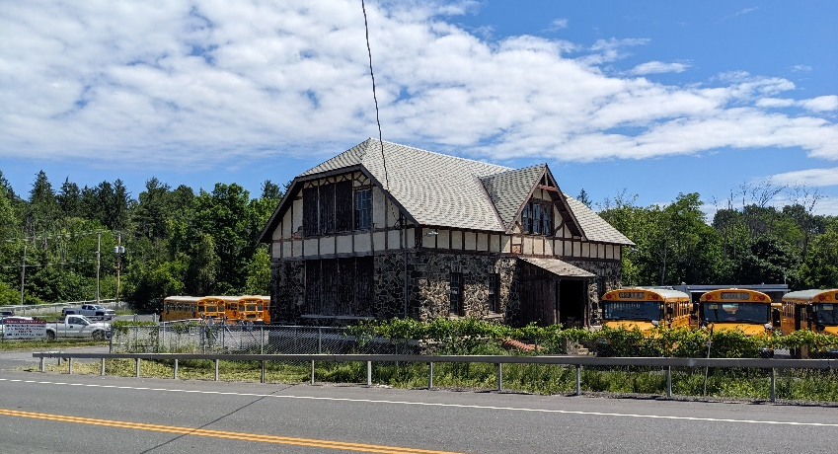
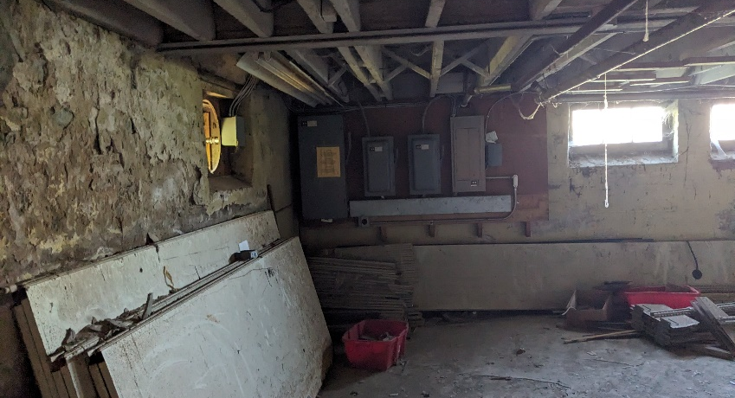
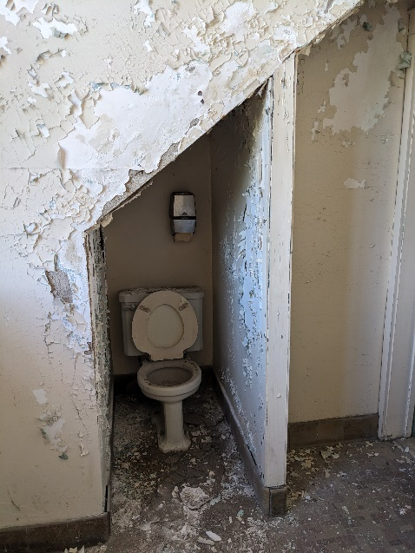
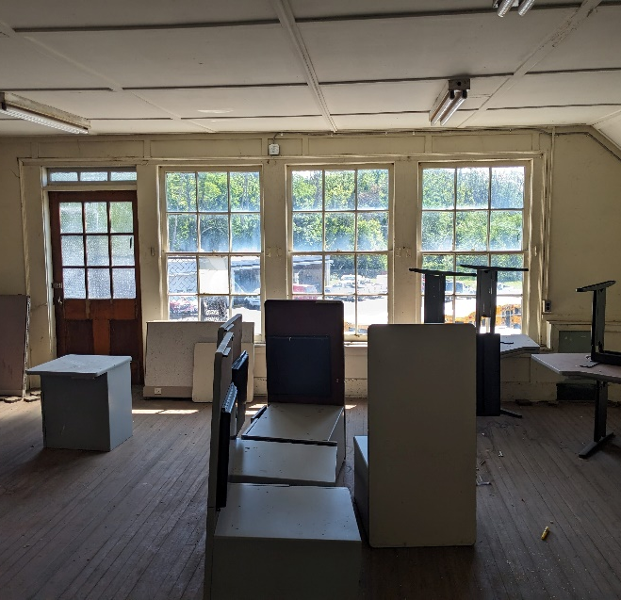
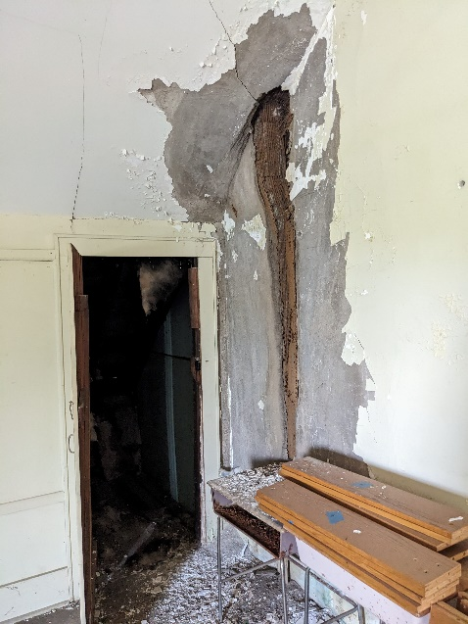
Proposed Scope of Work
Beukendaal Building
Abatement / Removal of Beukendaal Building

Slide 4
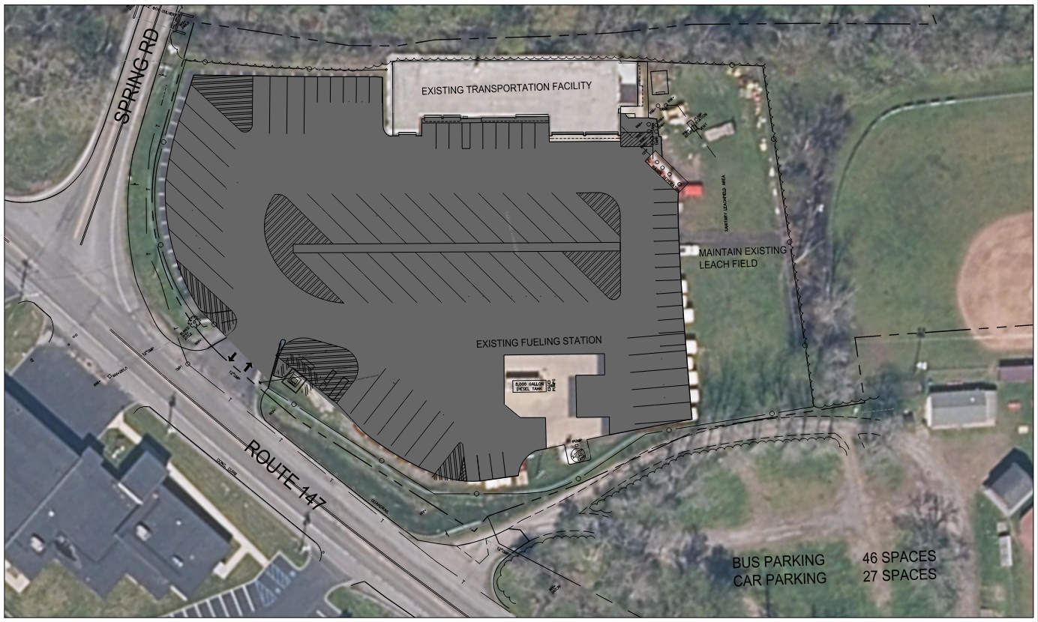
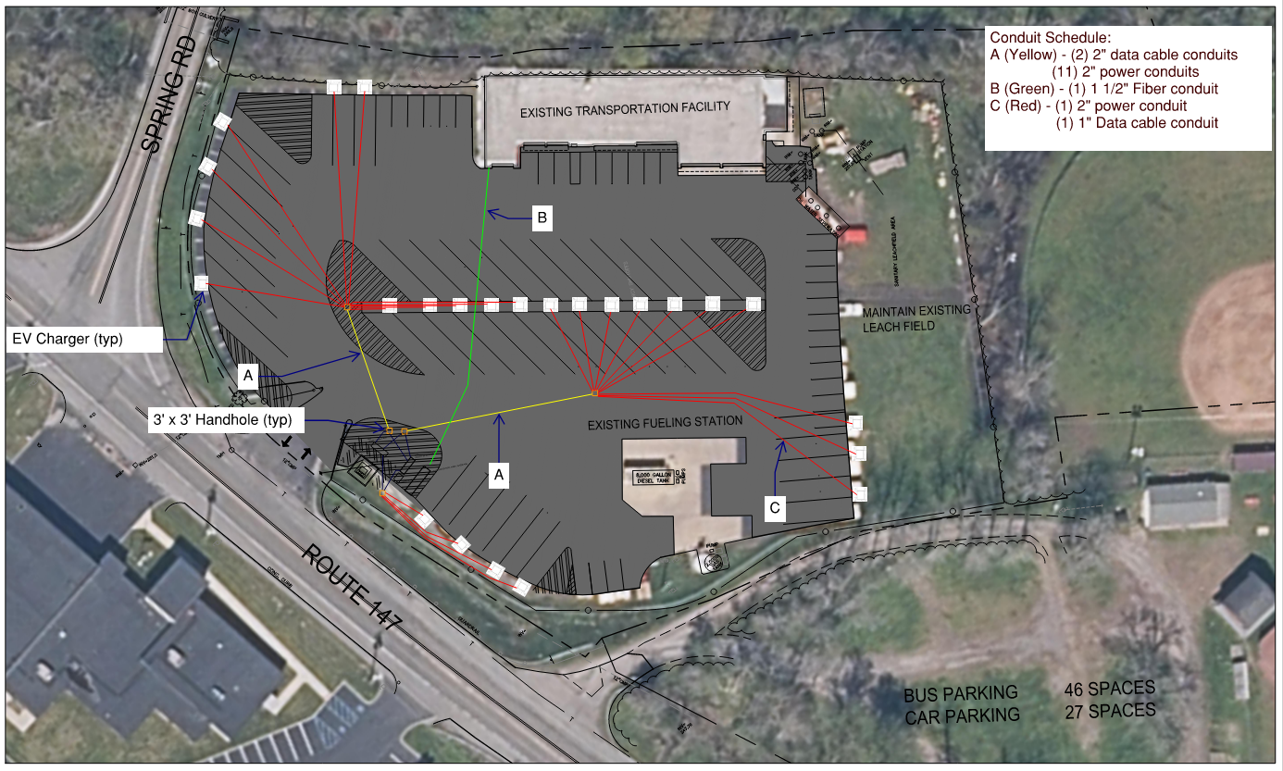
Proposed Scope of Work
Electrical Service Upgrade
New transformer, switchgear, generator
Preparation for future charging pedestals

Slide 5
Proposed Scope of Work
Sequence of Operations (tentative)

Slide 6
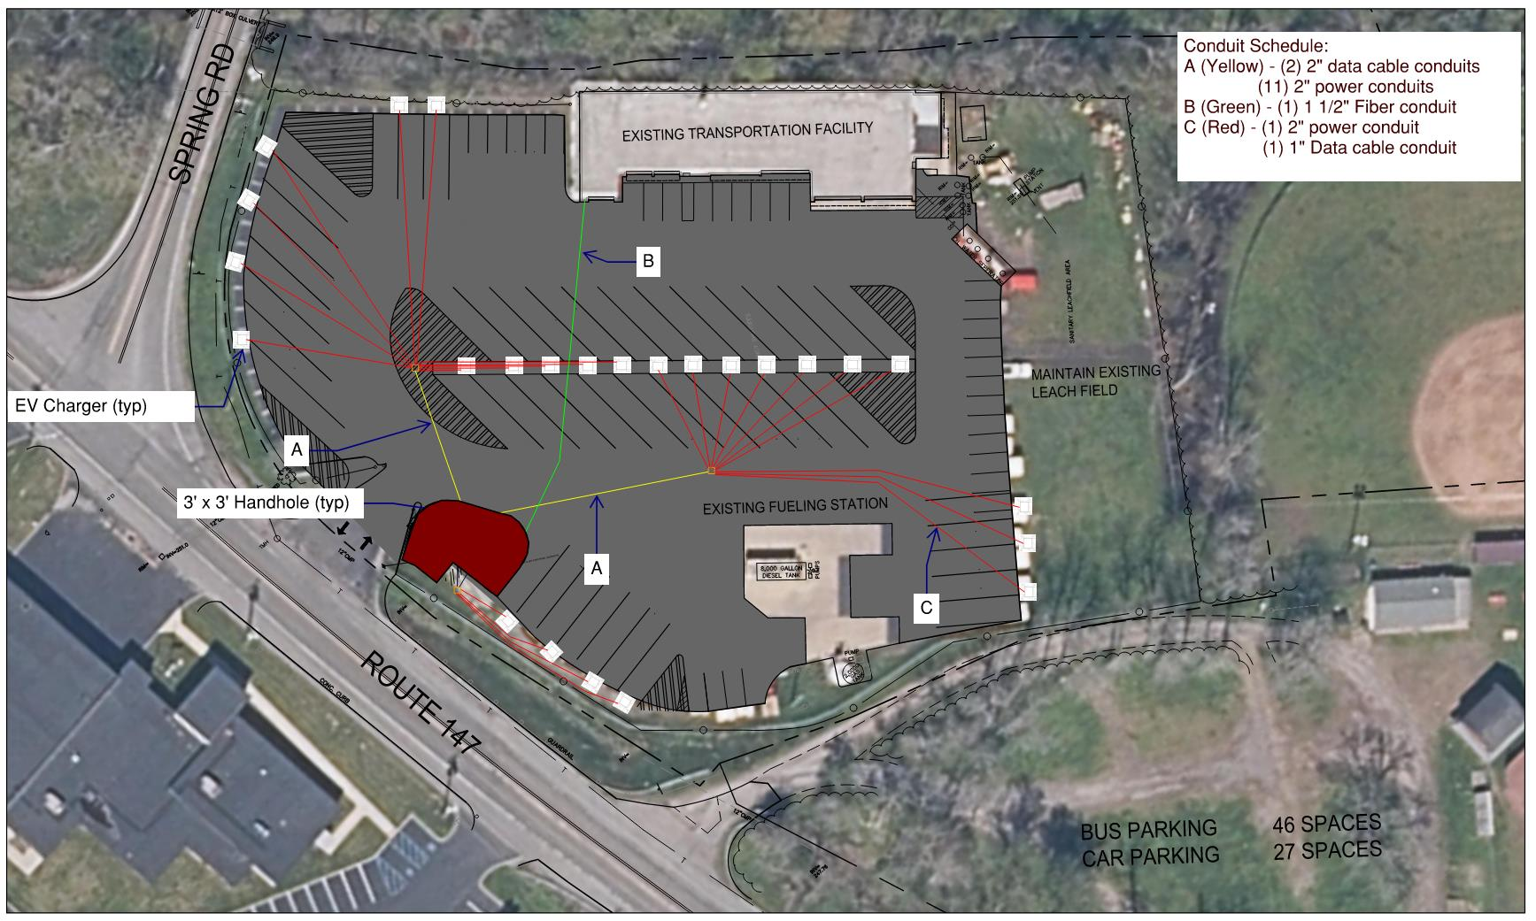
Proposed Scope of Work
Sequence of Operations (tentative)
Beukendaal Building abated and demolished

Slide 7
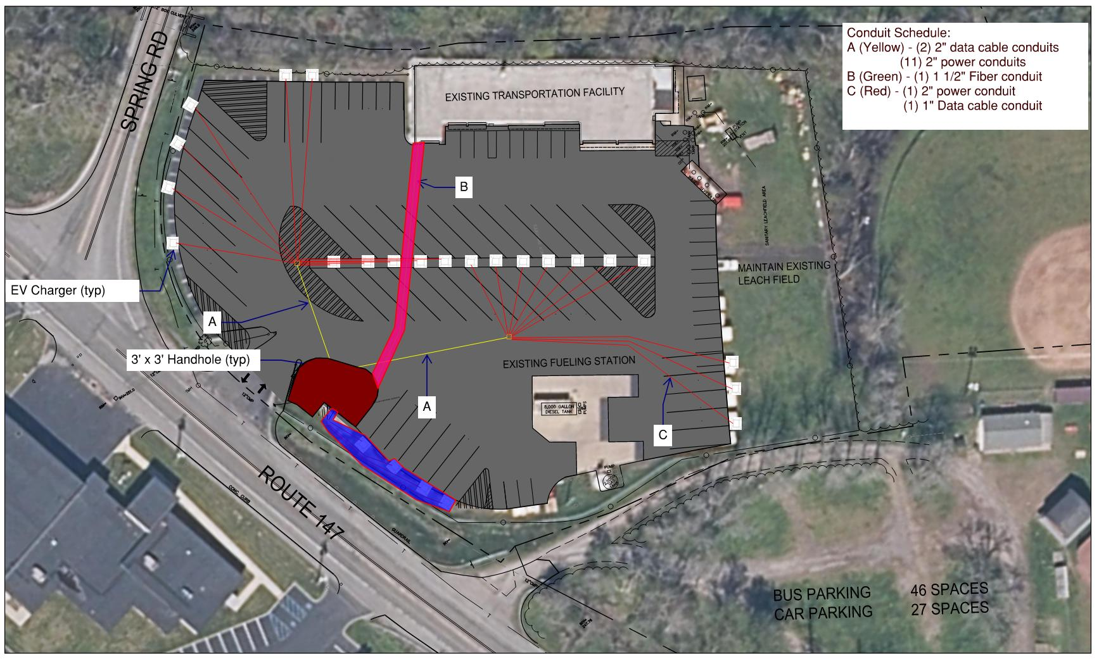
Proposed Scope of Work
Sequence of Operations (tentative)
Beukendaal Building abated and demolished
New transformer and pad, generator, ATS installed

Slide 8
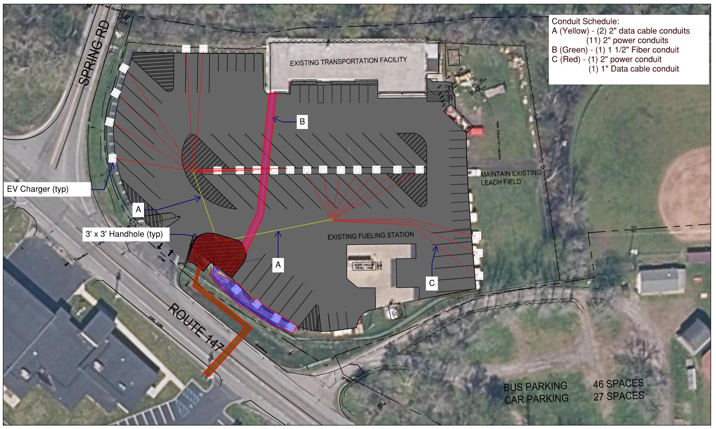
Proposed Scope of Work
Sequence of Operations (tentative)
Beukendaal Building abated and demolished
New transformer and pad, generator, ATS installed
National Grid replacement of primary feed and energize

Slide 9
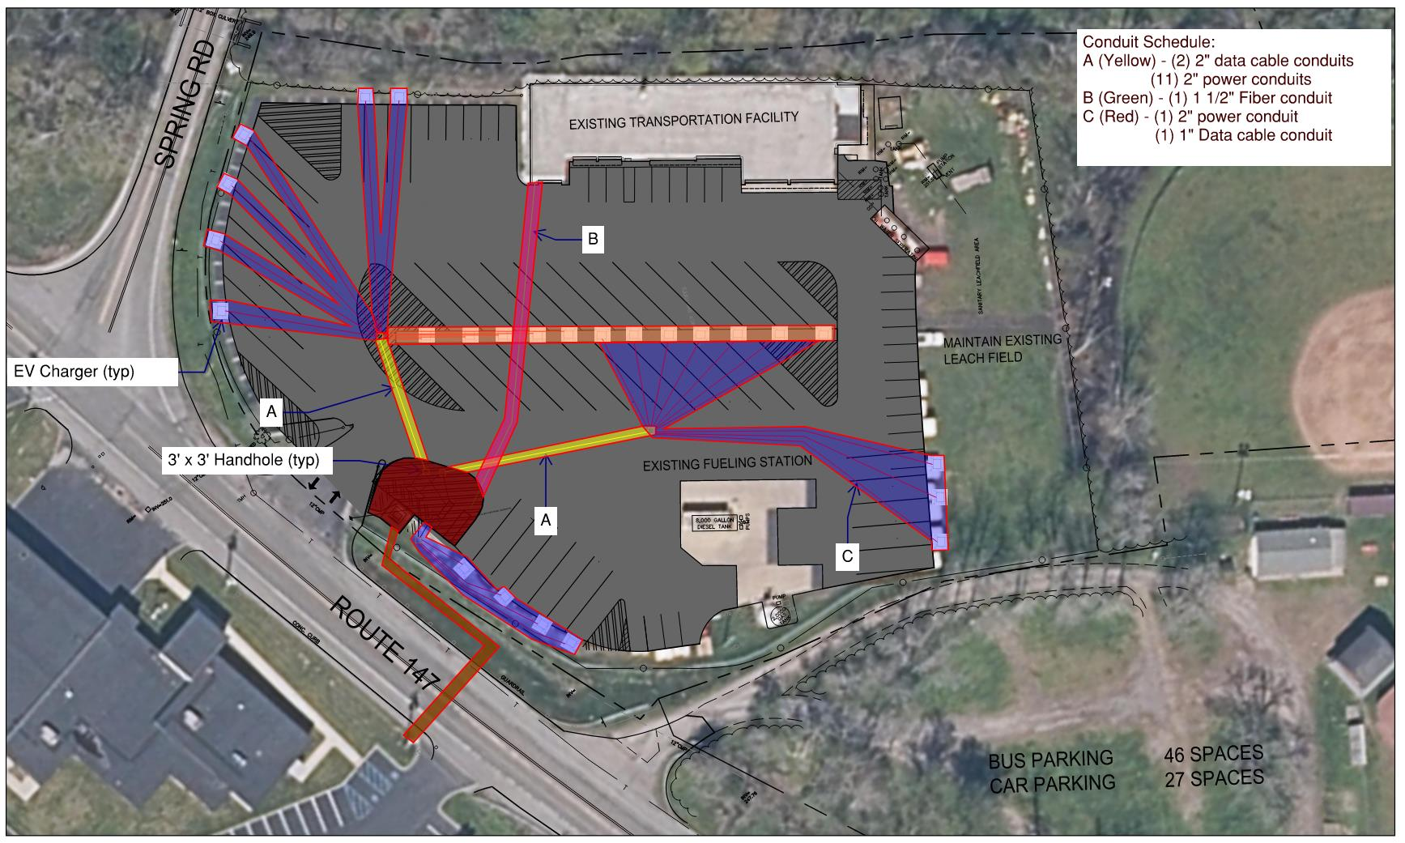
Proposed Scope of Work
Sequence of Operations (tentative)
Beukendaal Building abated and demolished
New transformer and pad, generator, ATS installed
National Grid replacement of primary feed and energize
Conduit installed throughout parking lot with HD handholes

Slide 10
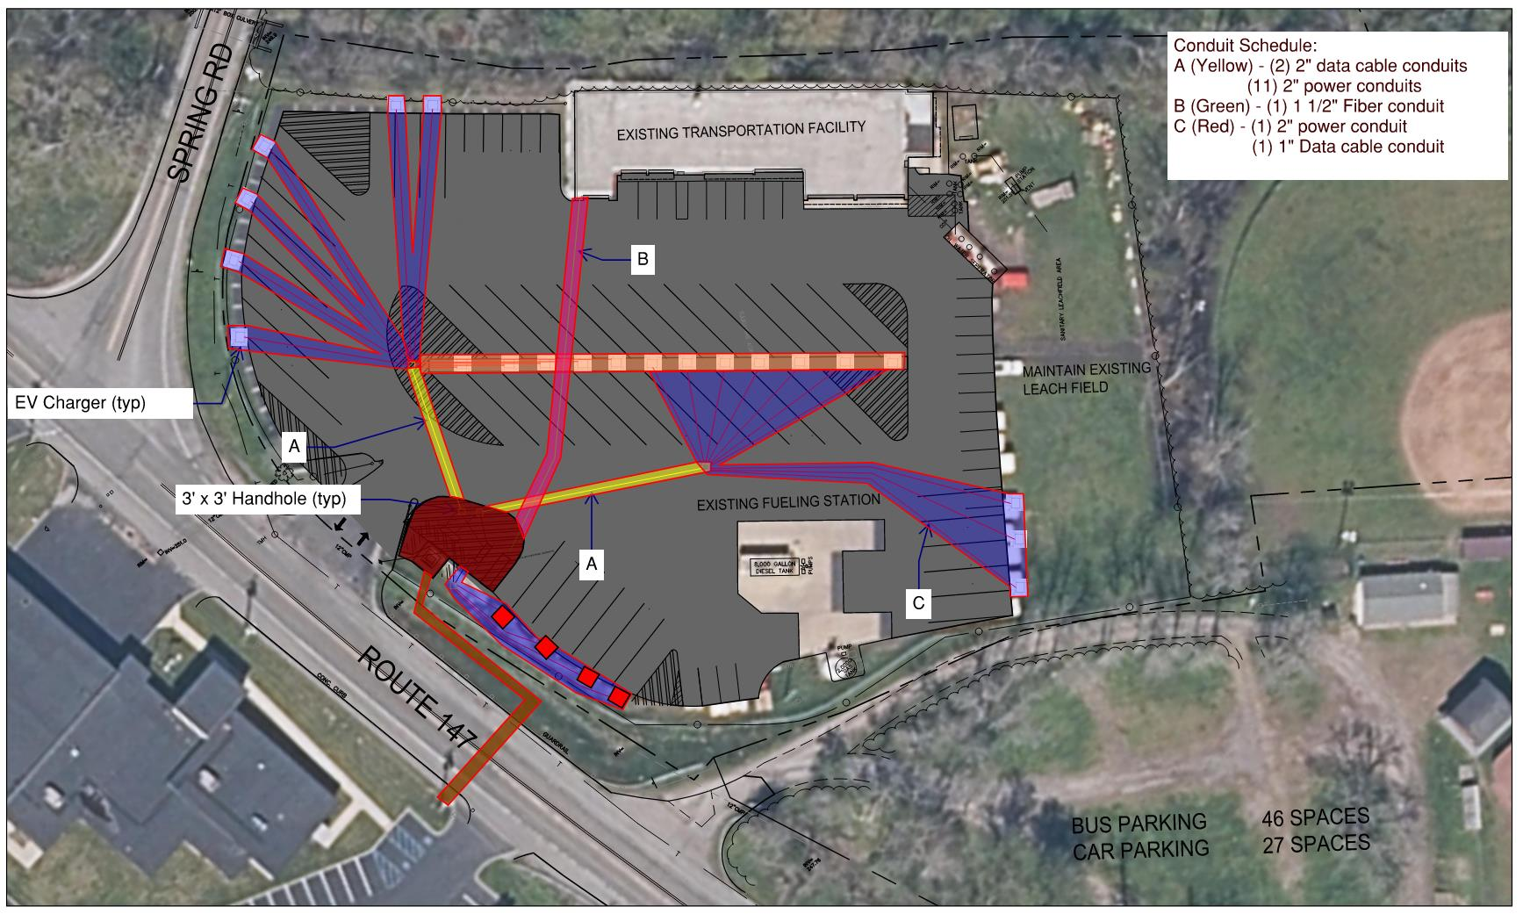
Proposed Scope of Work
Sequence of Operations (tentative)
Beukendaal Building abated and demolished
New transformer and pad, generator, ATS installed
National Grid replacement of primary feed and energize
Conduit installed throughout parking lot with HD handholes
Install Level 3 charger(s)

Slide 11
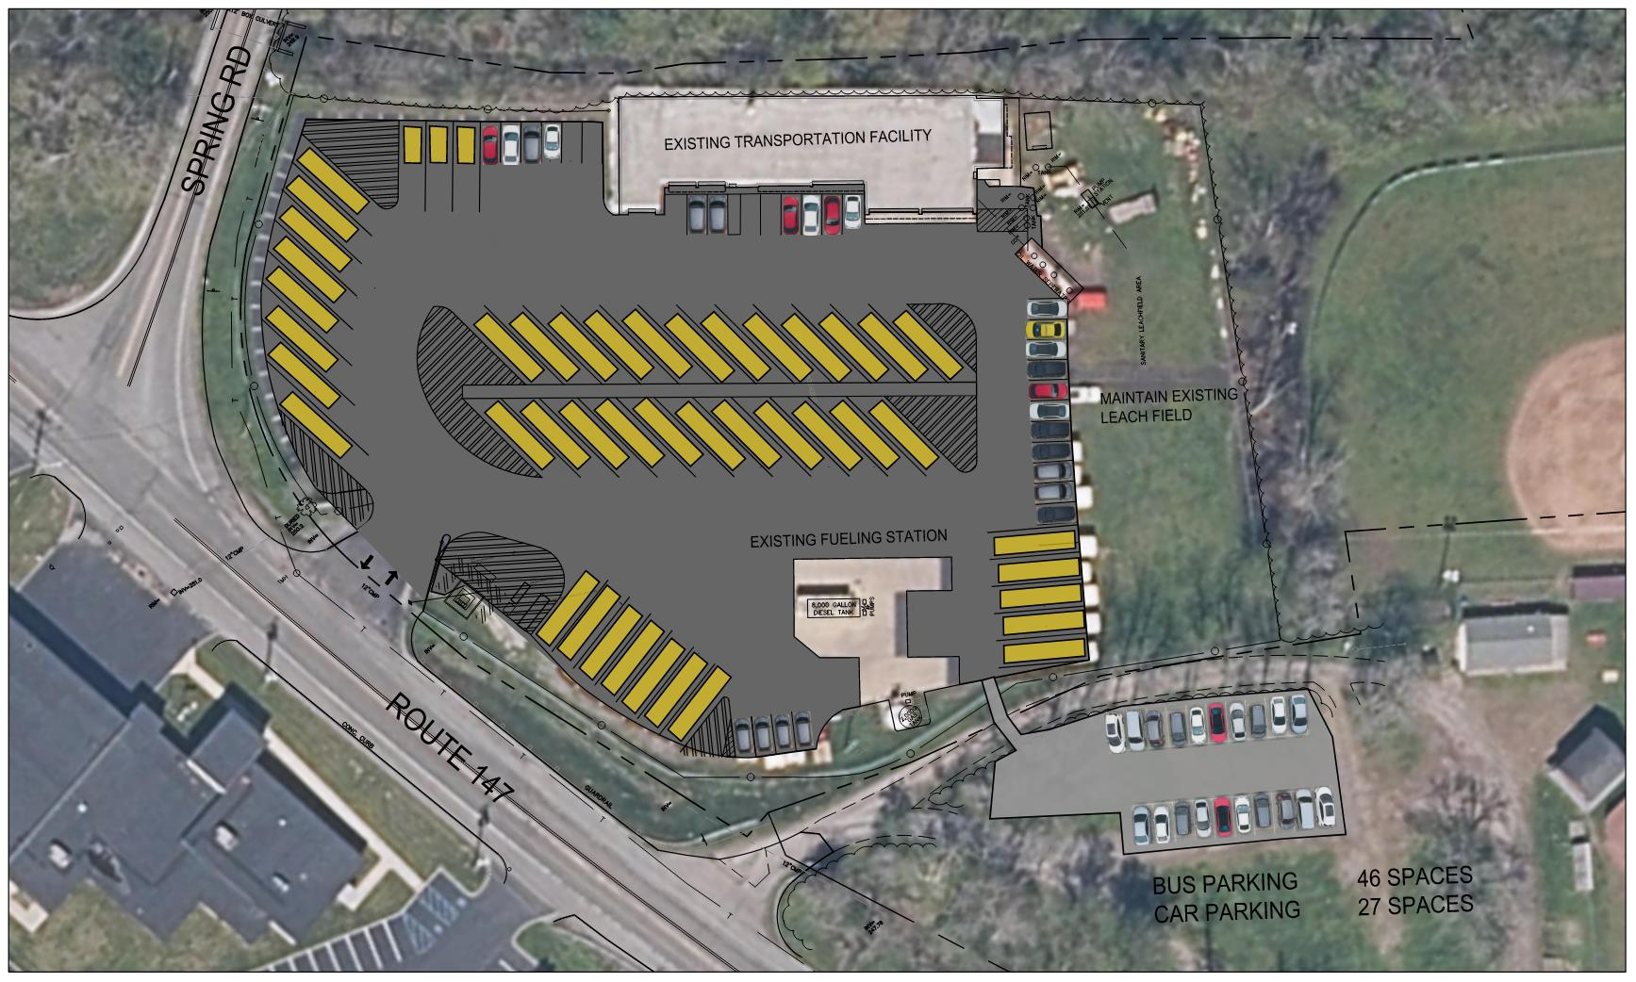
Proposed Scope of Work
Bus Garage Parking Lot
Full Replacement of asphalt
Additional parking on adjacent property

Slide 12
Proposed Budget
$2,600,000 Total Project Cost
$213,840 – Abatement and Removal of Beukendaal Building
$256,608 – Electrical Service Upgrade
$249,480 – Initial Charging Stations
$718,208 – Electrical Infrastructure
$356,400 – Generator
$520,344 – Parking Lot Reconstruction / Resurfacing
$42,768 – Additional Overflow Parking
$242,352 – Stormwater Management / Fencing
All costs include construction contingencies and incidentals

Slide 13
Financial Overview
Building Aid ratio – 76.8%
Based on current project about $1,031,840 will qualify for building aid
Building aid is paid out for 15 years
Financing to match (similar to past capital project)
Transportation Aid ratio – 72.7%
Based on current project $1,354,320 will qualify for transportation aid
Transportation aid is paid out over 12 years
Elements of the project that are EV dedicated will receive Transportation aid
Beukendaal building will not receive aid - $213,840
Facilities that are not student occupied spaces are not aidable, the one exception to this is transportation facilities

Slide 14
Financial Overview
Other Key Financial Factors
National Grid will rebate 90% of the cost of the upgrade to the electrical service including the transformer
Total cost estimated at $148,500
National Grid rebate of $133,650
The District would not have to long term finance the $133,650
NYSERDA Funding for 5 chargers - $55,000 each
$275,000 that District will not have to finance long term, pending approval of the electrification plan
District will contribute funds to offset borrowing
$550,000 of District funds would result in the project not having an increase on taxes
Amount is sized so that the debt service each year is equal to or less than the aid
Aid is based on the project and not the debt service

Slide 15
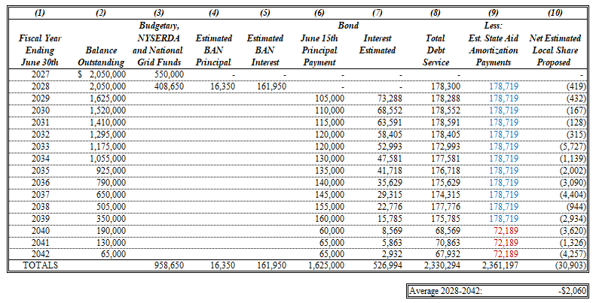
Financial Overview
Estimated Debt and Aid Schedule

Slide 16
Financial Overview
Summary of Important Factors

Slide 17
Proposed Timeline
Monday Nov 4 SEQRA Introduction & Financial Update
Monday Nov 11 SHPO Application Submitted to OPRHP
Monday Jan 13 Final Scope Confirmation Update. Declare Intent to be Lead Agency
Tuesday Jan 14 Letter to Interested Agencies (Unlisted, Coordinated Review)
Jan 14 - Feb 17 SEQRA Evaluation Period (30 days)
Monday Feb 24 Determination of SEQRA Lead Agency,
Determination of SEQRA Significance & Board Resolution for SEQRA Negative Declaration.
Monday Mar 24 Board Resolution for Voter Referendum Resolution Language
Mar 24 – May 12 Public Notice and Comments Period
Friday April 11 Project Graphics to District
Friday April 18 Mailers Out
Monday May 5 Capital Project Public Presentation
Tuesday May 20 Budget and Proposition Vote Date

Slide 18
Proposed Project Schedule
Project Design
Mar – Jun 2025 (4 months pending voter approval)
NYSED Review (Third Party Review)
Jul - Aug 2025
Bidding
Sep 2025
Construction
Oct – Dec 2025 Abatement / Removal of Building
Winter Break Installation of all conduits & handholes
Spring Break Installation of transformer & switchgear
Jul – Aug 2026 Parking Lot Reconstruction
Mid Aug 2026 Installation of (5) chargers
(2) dual level II charger & (1) level III charger
Late Aug 2026 First EV bus arrives

Slide 19
Bus Replacement Schedule
EV Bus Purchasing
2026 First (4) EV buses arrive
2027 Purchase of (5) EV buses
2028 Purchase of (5) EV buses
2029 Purchase of (5) EV buses
2030 Purchase of (5) EV buses
2031 Purchase of (5) EV buses
2032 Purchase of (4) EV buses
2033 Purchase of (4) EV buses
2034 Purchase of (5) EV buses
2035 Purchase of (3) EV buses
Chargers will be a combination of dual level 2 chargers and select fast charge level 3, where appropriate

Slide 20
Questions?

Slide 21
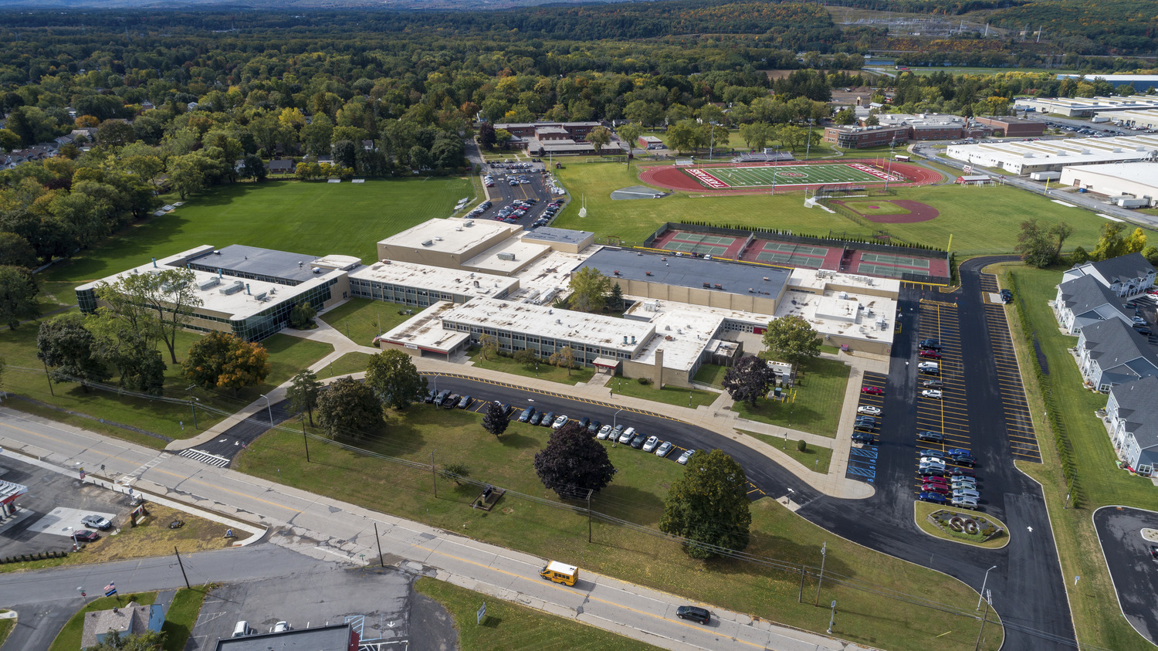
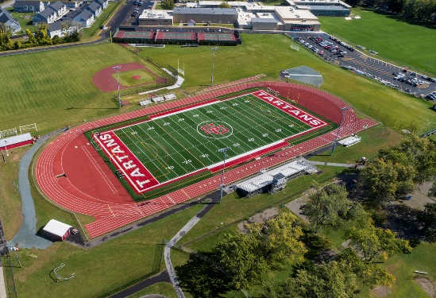
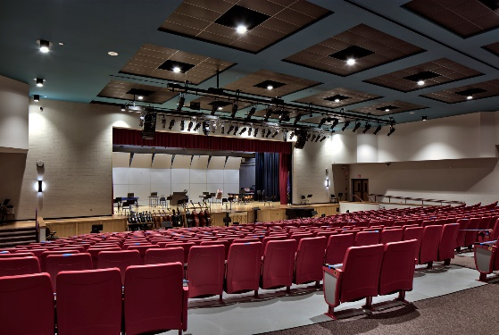
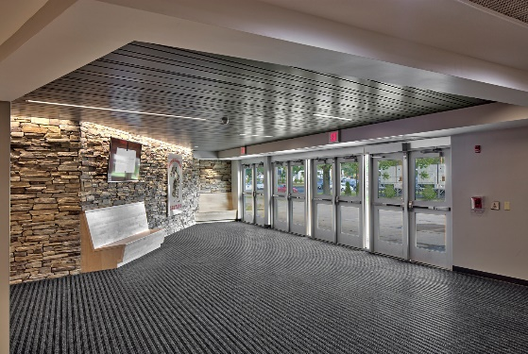
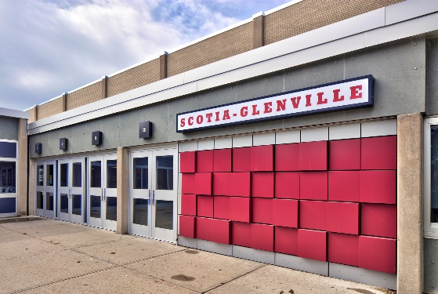
Thank You

