Slide 1
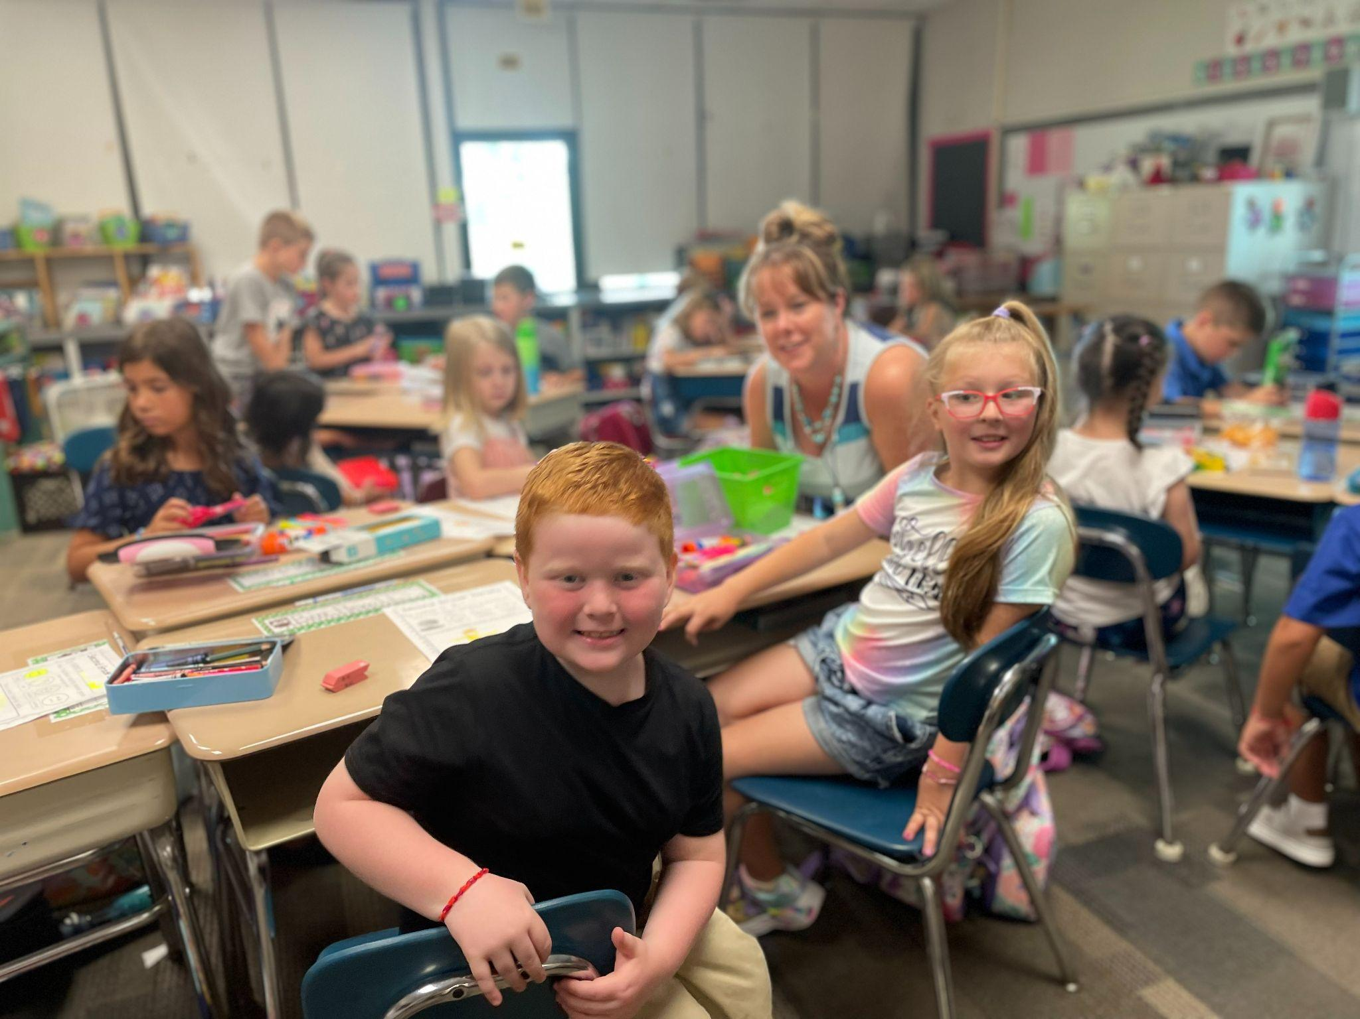
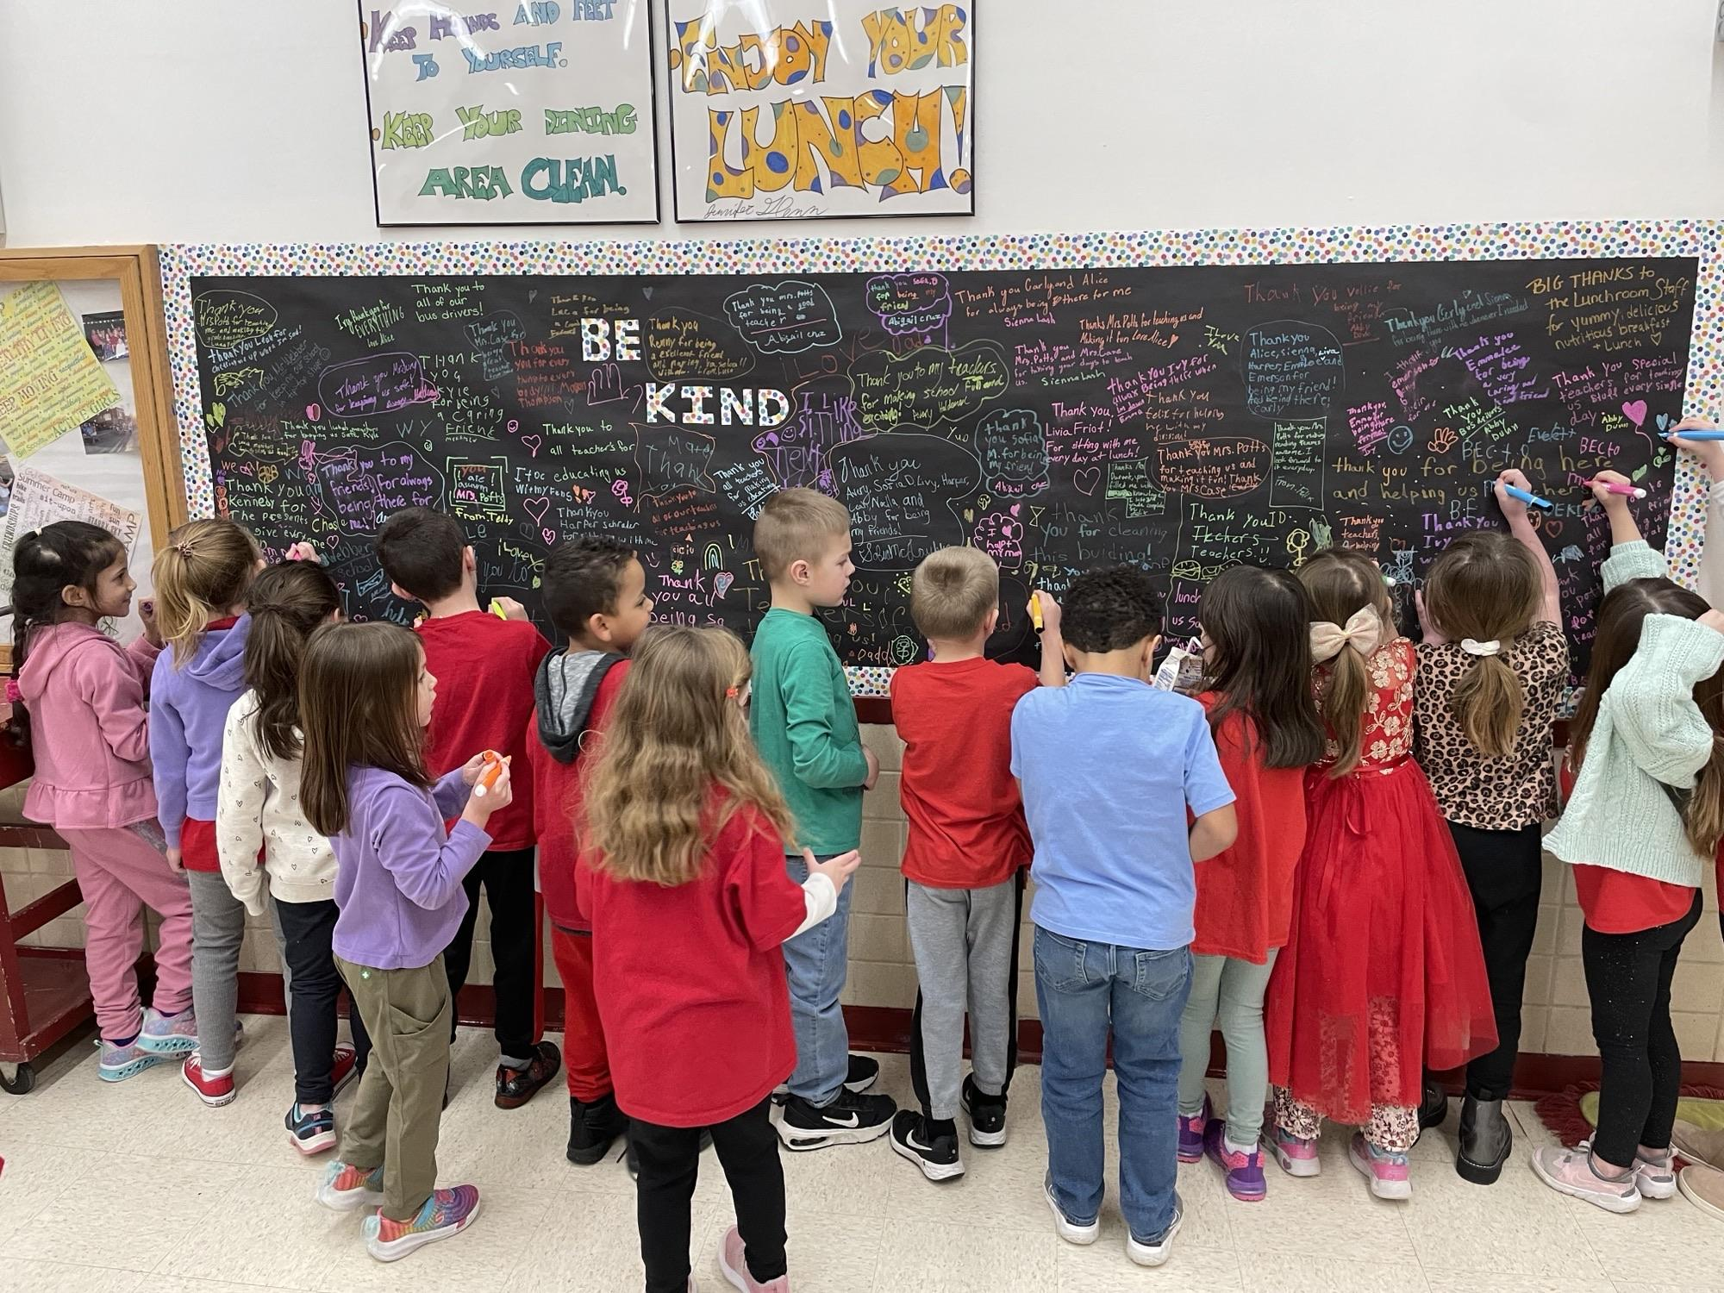
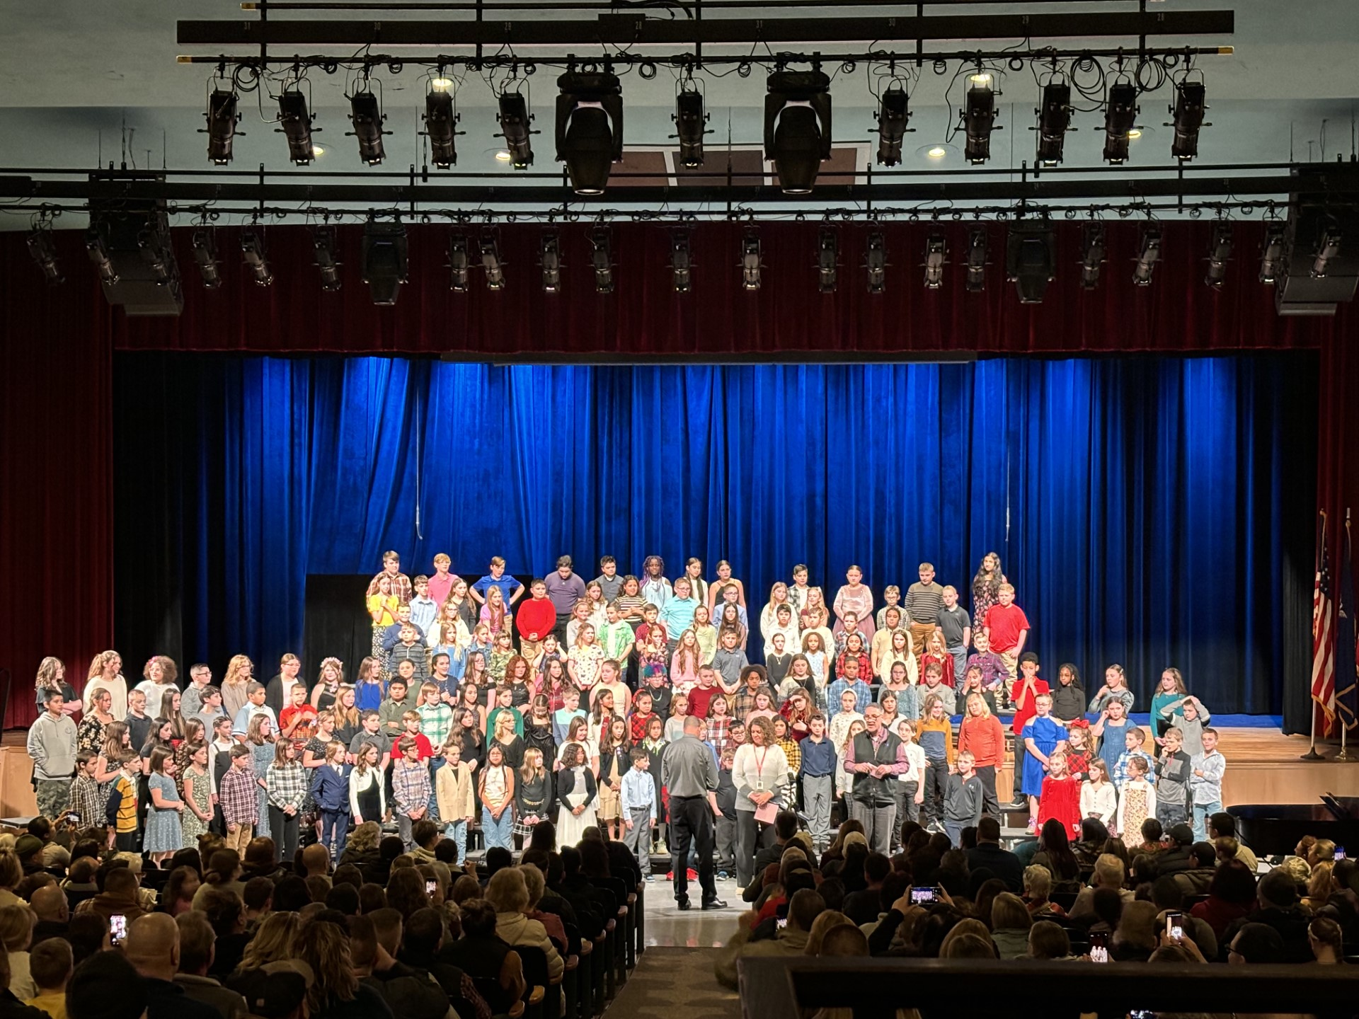
Elementary Curriculum & Program Update
26 Feb 2024

Slide 2
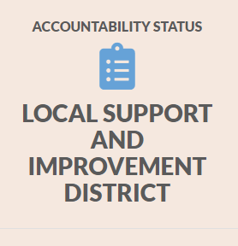
Every Student Succeeds Act (ESSA) Update
Federal mandate → NYSED Accountability System → School Report Card

Slide 3
ESSA Accountability Metrics
Elementary / Middle School
NYS 3-8 ELA / Math / Sci Tests
Chronic Absenteeism Rate
English Language Proficiency *
High School
NYS Regents Exams
Chronic Absenteeism Rate
English Language Proficiency *
Graduation Rate

Slide 4
ESSA Accountability Status
 | Status
District | LSI: PTD
GD | LSI
GW | LSI: PTSI
LINC | LSI
SAC | LSI
MS | LSI
HS | LSI
LSI | Local Support and Improvement (formerly referred to as “Good Standing”)
PTD | Potential Target District
PTSI | Potential Target Support & Improvement

Slide 5
ESSA Accountability Status: Elementary & Middle
All Students | Status | Weighted Avg Achieve Level | Core Subject Performance Level | Chronic Absenteeism
District | LSI: PTD | 3 | 3 | 3
GD | LSI | 4 | 4 | 4
GW | LSI: PTSI | 2 | 3 | 4
LINC | LSI | 3 | 3 | 2
SAC | LSI | 3 | 2 | 4
MS | LSI | 2 | 3 | 2
Level | Statewide
1 | 0 - 10%
2 | 10.1 - 50%
3 | 50.1 - 75%
4 | 75.1 - 100 %
LSI | Local Support and Improvement
PTD | Potential Target District
PTSI | Potential Target Support & Improvement

Slide 6
ESSA Accountability Status: High School
All Students | Status | Weighted Avg Achieve Level | Core Subject Performance Level | Graduation Rate (4,5,6 yr avg) | Chronic Absenteeism
HS | LSI | 3 | 3 | 2 | 4
Level | Statewide
1 | 0 - 10%
2 | 10.1 - 50%
3 | 50.1 - 75%
4 | 75.1 - 100 %

Slide 7
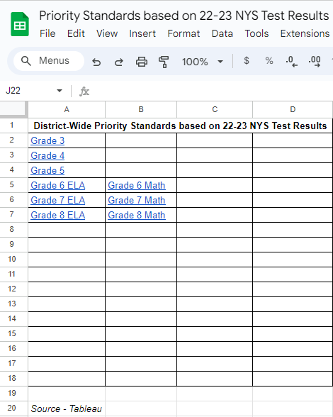
ESSA Accountability Status
Next Steps:
Building-level focus on priority metrics
Emphasis on NYS 3-8 Test Participation
Empower staff with both meaningful & actionable data

Slide 8
Learning Target / Purpose
To convey how our elementary curriculum aligns with our district mission to provide an environment which allows students to realize their full potential and thus prepares them for life in an ever-changing world.

Slide 9
NYSED Part 100 Elementary Requirements

Slide 10
Sample Elementary Schedule
8:30 - 8:45 | Breakfast in the classroom
8:45 - 9:00 | Responsive Classroom
9:00 - 9:30 | ELA Fundations
9:30 - 10:00 | ELA Whole Group
10:00 - 10:10 | Snack
10:10 - 10:40 | ELA Guided Reading
10:40 - 11:20 | Specials
11:25 - 11:55 | Lunch
12:00 - 1:00 | Math
1:00 - 1:25 | Recess
1:30 - 2:00 | Academic Intervention
2:00 - 3:00 | Science / Social Studies

Slide 11
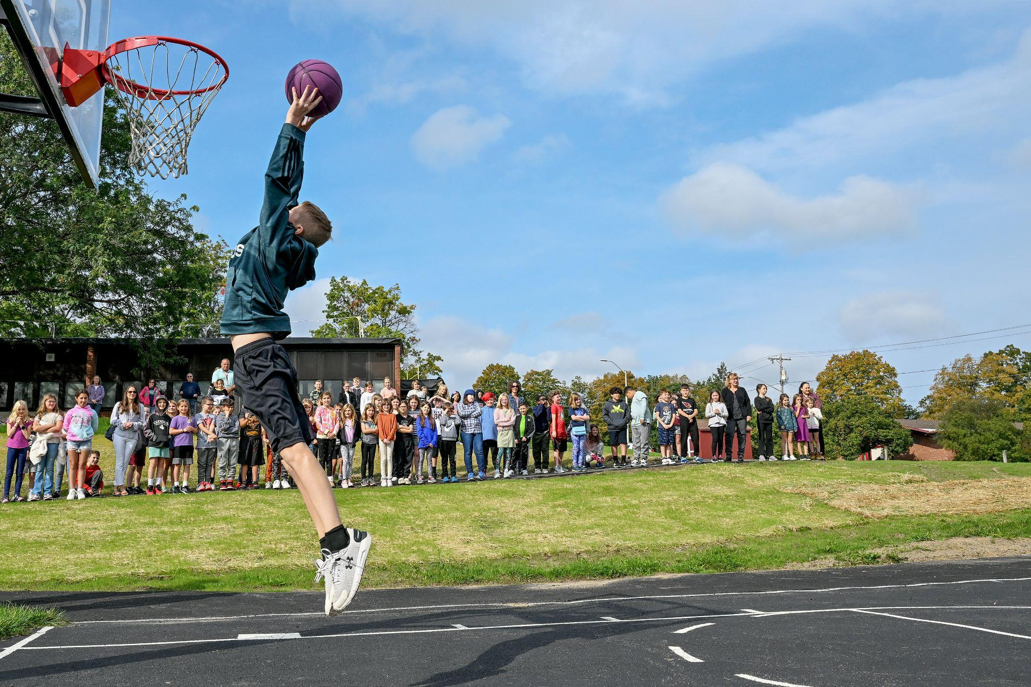
Elementary Special Areas
All K-5 students receive instruction in all 4 special areas. Special area classes meet on a 6 day rotation and are 40 minutes long.
Special Areas:
Library 1 Day out of the 6 day rotation
Art 1 Day out of the 6 day rotation
Music 1 Day out of the 6 day rotation
PE 3 Days out of the 6 day rotation

Slide 12
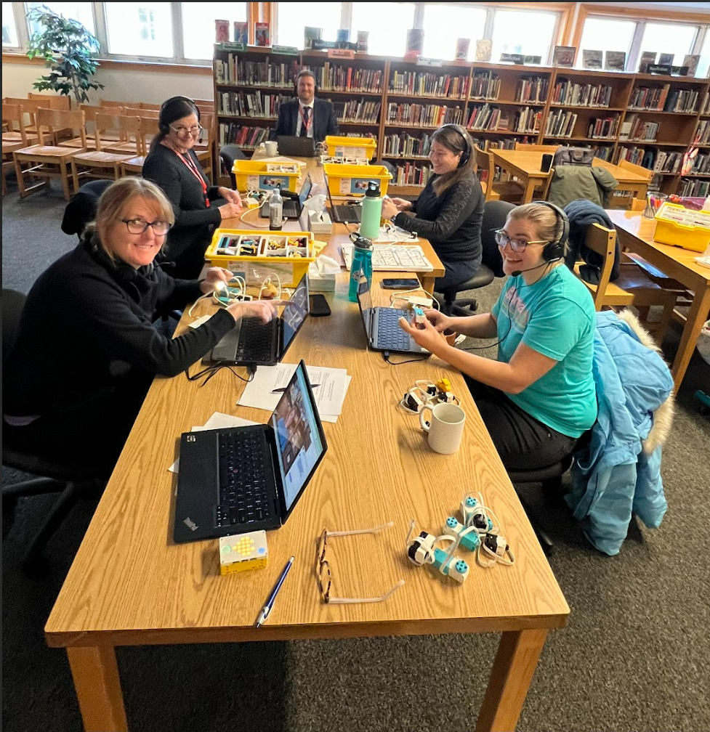
K - 5 Enrichment: iOpal
Opportunities and Programming for Advanced Learners
Facilitated by School Library Media Specialists
Focus on STEAM / Design Thinking in Gr 3 -5
Video Game Design
Lego Spike Prime Coding & Robotics
 | iOpal Enrollment
2022 - 2023 | 88 students
2023 - 2024 | 125 students
Notes:
Rick

Slide 13
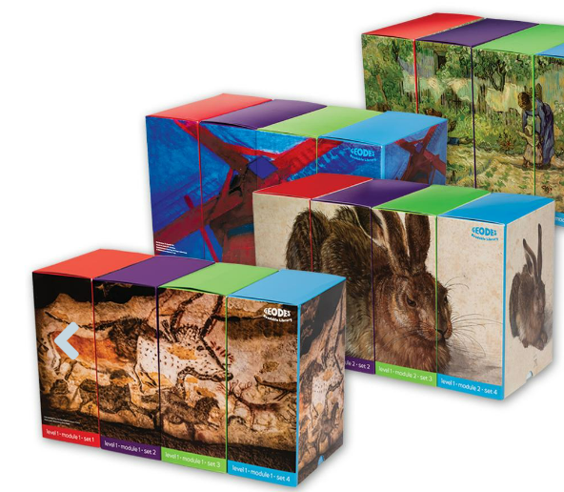
ELA
Next Generation ELA Standards were revised in 2017. We adopted McGraw-Hill’s Wonders in 2015 and updated to a newer version in 2023. Our focus since 2020 has been on priority standards. Grade level teams worked to identify the priority standards in order to focus the instruction and align the assessments in Wonders to the priority standards.
Utilize McGraw-Hill Wonders for grade-level reading and writing instruction K-5 (30 minutes daily K-2, 60 minutes daily 3-5)
Utilize Fundations for explicit phonics instructions K-2 (30 minutes daily)
Utilize a variety of leveled and decodable text for guided reading K-5 (30 minutes daily K-5)
Notes:
Tonya

Slide 14
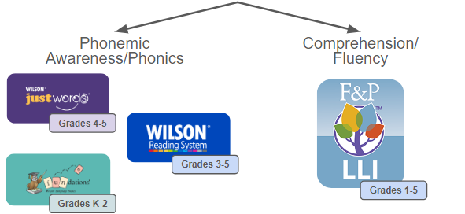
ELA Intervention
Students work in small groups during scheduled RTI time with reading teachers, special education teachers, or classroom teachers to receive targeted instruction in areas of need. We utilize specific criteria (including reading level, aimswebPlus assessments, Fundations assessments, and NYS test results) at each grade level to determine which students qualify for Tier 2 or Tier 3 interventions.
Notes:
Tonya

Slide 15
Eureka Math²
This is our first year 1 using Eureka Math²
The program combines memorization & goes deeply into conceptual understanding, comprehending why a mathematical concept is significant & how it can be applied in various situations.
Understanding the why & how of concepts also helps with retention because facts & methods are easier to remember & apply when learned through understanding.
Notes:
Nick

Slide 16
Eureka Math²
Practice
Practice problems for each lesson include mixed practice of related skills. This helps students solidify their conceptual understanding & procedural skills, transfer knowledge to new applications, and build fluency.
Each Practice is structured as two pages. The front page includes problems that represent learning from class that day, helping to solidify new learning. The second page includes Remember problems, helping to retain previously learned skills. Gr. 1 Sample Gr. 4 Sample

Slide 17
Eureka Math²
Practice Partners
Each Practice has a parallel supporting Practice Partner that shows problems like those worked on in class & an example of the thinking that helps students solve those problems.
Practice Partners serve as a useful tool for students to solve the Practice & Remember problems, as well as a guide for families who are supporting their student with the Practice and Remember problems at home: Gr. 4 Sample Gr. 1 Sample

Slide 18
Eureka Math²
Digital component
Fully integrated, from practice to assessments
Students can view their virtual "to-do" list of assignments & assessments
Students can participate in live digital lessons during class
Students may view past work, including teacher feedback, on lessons and assessments given online, in their online student locker
Students can access virtual manipulatives

Slide 19
Eureka Math²
Manipulatives
Materials & tools writers created to develop student understanding & maximize learning
Digital Manipulatives: Tools allow students to create, manipulate, & erase math work.
Physical Manipulatives: Provided to each classroom teacher
Home support
Family Math letters provide a topic overview that includes a content narrative, images of models & strategies, & key terminology so parents have a solid understanding of what students are learning in the classroom, why they're learning it, & how parents can help reinforce this at home. K sample Gr. 4 Sample
The Family Math letters & the Practice Partners explain the step by step process for students to complete their homework independently. This empowers families with tools to help guide their child if they struggle, using the process taught to the child in class. Gr. 4 Sample

Slide 20
Eureka Math²: Professional Development
Summer 2023
Launch: Bringing Eureka Math² to Life
Focused on understanding the structure, design and components of the program
Teach: Effective Instruction with Eureka Math²
Study the content of a module, topic & lesson by previewing the learning, investigating learning development & exploring the assessments.
Winter 2024
Assess: Embedded Opportunities to Inform Instruction
Understanding the full suite of assessments. Their design, the role each plays in instruction, & how they work together to give a complete picture of student learning.
Summer 2024
Adapt: Optimizing Instruction & Accelerate: Assessments
To expand capacity to effectively use the curriculum materials & student data to plan for and optimize Instruction

Slide 21
Math Intervention
Students work in small groups or 1:1 two to three days per week during scheduled Response to Intervention (RTI) time with their classroom, special education or reading teachers to receive targeted instruction in areas of need.
We utilize specific criteria (aimswebPlus assessments, Eureka Math² assessments, & NYS test scores) at each grade level to determine which students qualify for Tier 2 or Tier 3 interventions.

Slide 22
Social Studies
Instructional Minutes - 30 min daily or 60 min every other day. Determined by building schedule and the science kit rotation.
Curriculum Guidelines - Instruction is aligned with the NYS Social Studies Framework 2017. Framework is anchored in the NYS learning standards for ELA.
2016-2017- A full curriculum review was conducted K-5
Grade level teams met throughout the year to do a crosswalk with our current Wonders ELA curriculum and standards. What SS standards can be covered through our ELA instruction?
Every grade level created a grade level curriculum crosswalk identifying the SS standards covered in ELA and the standards covered during SS along with instructional guidelines/materials. Shared Google files.
Grade 5- PNW Boces Integrated Social Studies/ELA Curriculum.
Currently there is no Social Studies State Assessment 3-5
Notes:
Tom

Slide 23
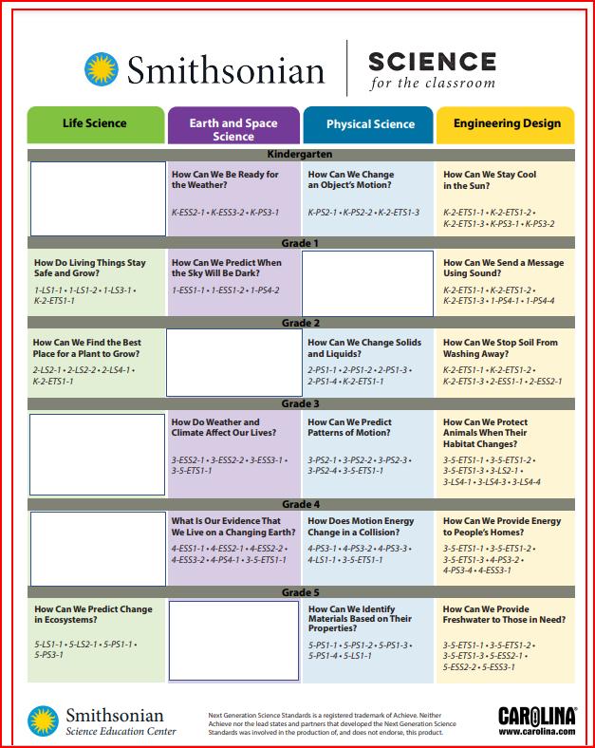
Science
2019 - Updated Science Kits
2022-2023
Created and piloted the four required NYS Investigations/labs. BOCES trained all 3-5 teachers.
3rd Grade- Circle of Life.
4th Grade- Light it Up.
5th Grade- What’s in the Bag?
5th Grade- Cloud in the Bottle.
May 2024
The new NYS Science Test will be administered to all 5th Graders.
2024-2025
Science Committee will analyze NYS Science test results. Identify possible curricular needs/gaps.
Science Instructional Minutes - 30 min daily or 60 min every other day. Determined by building schedule and the science kit rotation.

Slide 24
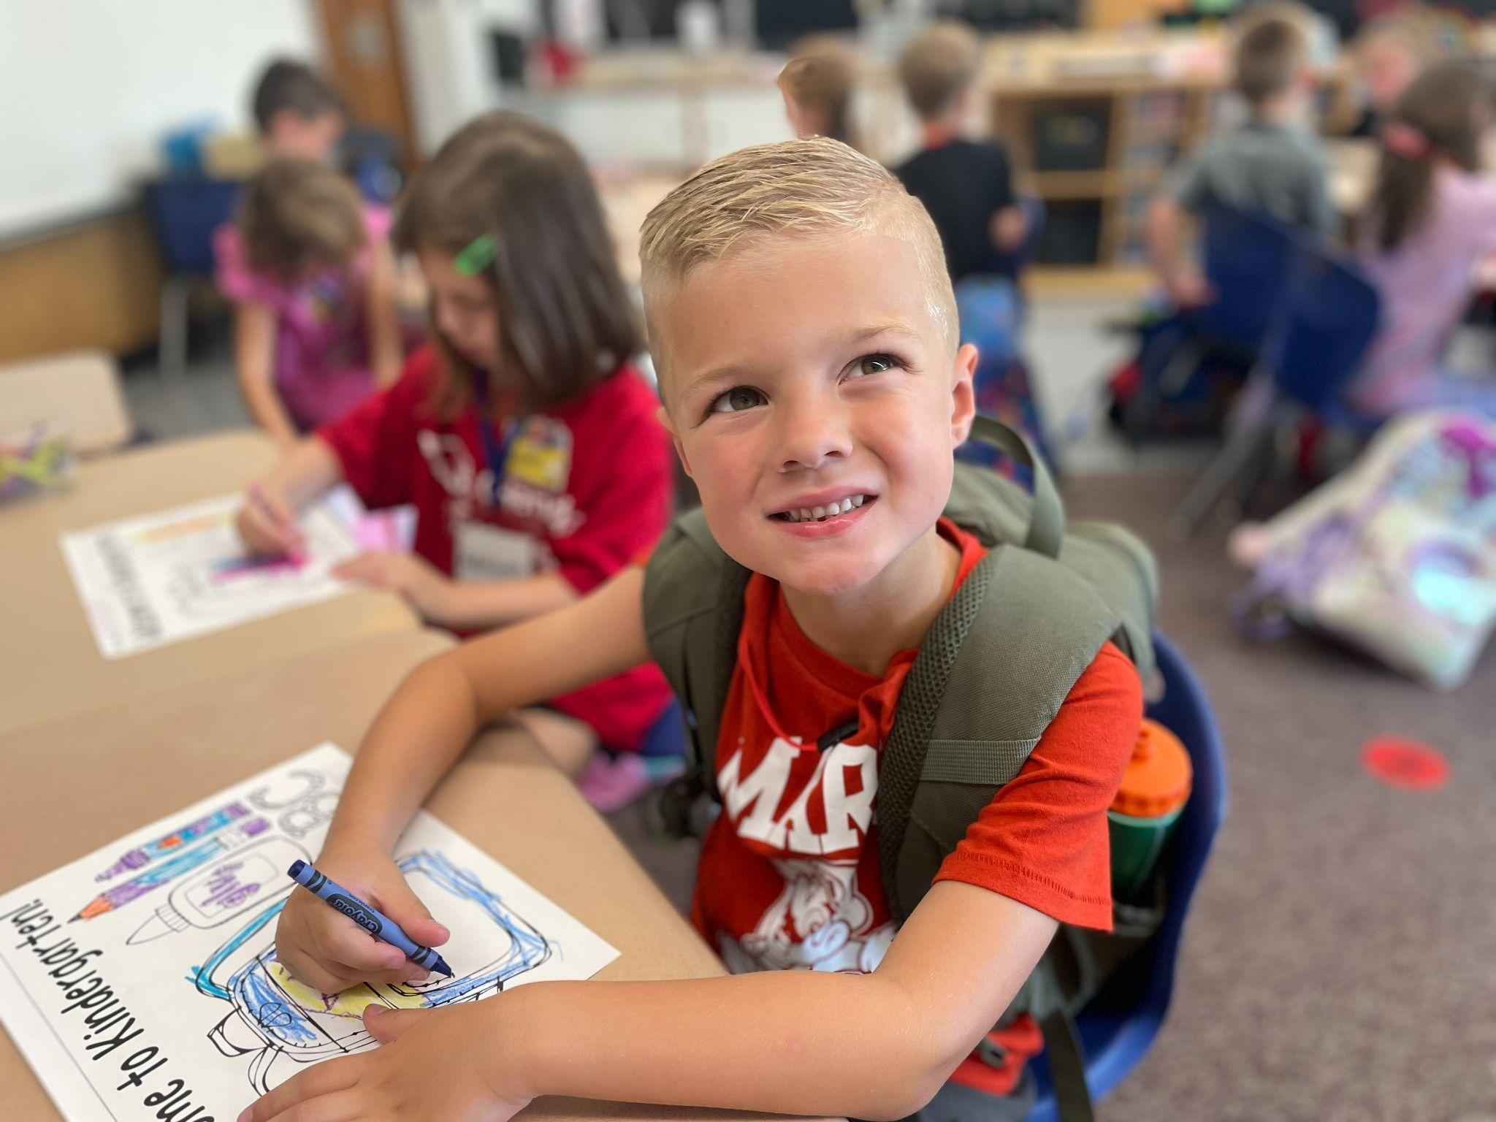
Our Ultimate Goal
To ensure that students are equipped with the skills and knowledge they need to find success after their experience at Scotia-Glenville.

